Slide 1
Data Privacy: Policies and Current Events Continued...
Presented By: Tenzing R, He W, Jiacheng Z.

Slide 2
Data protection in data privacy

Slide 3
Data Protection
Data protection is more specific.
It's concerned with the ways third parties handle the information they hold about us - how it is collected, processed, shared, stored, and used.
In other words, privacy is the big picture - data protection is one corner of it.

Slide 4
New Ways challenge for data protection
One challenge: the way companies use our data
The internet's business model depends on people sharing their personal data in exchange for access to content, services and social media platforms.
Another challenge: the collection of personal data by governments
Technological developments now enable governments to monitor our conversations,transactions, and the locations we visit.
The digital age has created new ways to collect, access, analyze and use data, often across multiple borders and jurisdictions. Unsurprisingly, this poses challenges for data protection

Slide 5


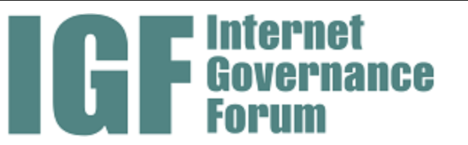

Mechanisms
International Level:
Following an UN resolution on the right privacy in the digital age, the Human Rights Council has established a new Special Rapporteur for Privacy. Various internet policy forums, like the Internet Governance Forum (IGF),the Council of Europe. Contribute to shape the scope of privacy in the digital age.
Companies:
The decisions of companies can also have a huge impact on data protection and privacy rights.
For example, by building end-to-end encryption into their software, as WhatsApp did in early 2016.

Slide 6
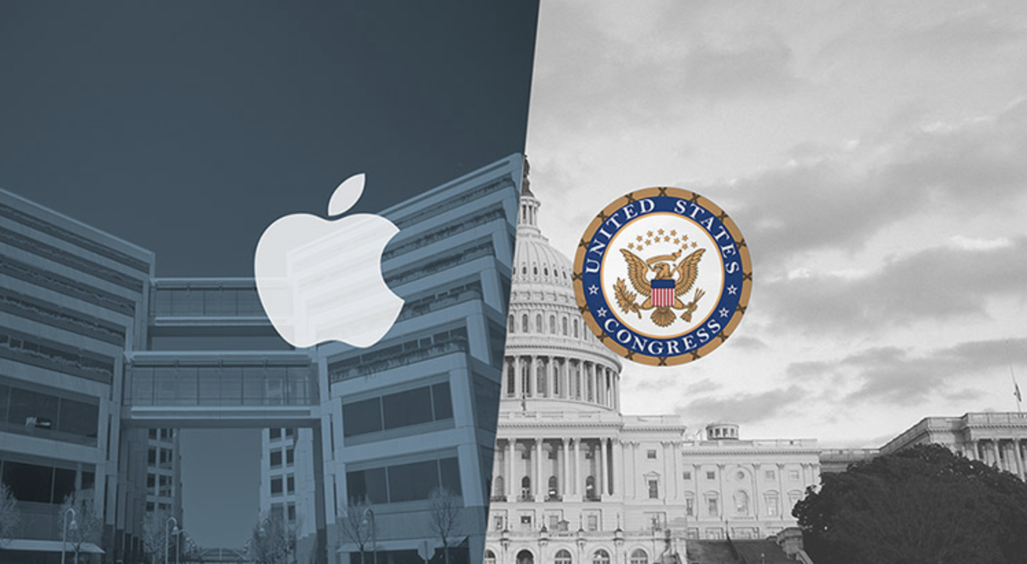
Data protection in the real world
Apple vs. FBI case
After 2016 terrorist attacks in San Bernardino.
FBI : the information of the suspects. Apple: Operating System is encrypted.
FBI: modified system for me. Apple: No.
FBI: Vulnerability.

Slide 7

Strengthen data protection
An easy step: taking digital security measures yourself.
For example, over the last few years, the number of users using adblock software globally has exploded. There is evidence that this is already pushing companies to less invasive advertising practices.
We also need to make sure legislation is keeping up with new technological developments - like the Internet of Things.
When people see how data protection and privacy affects them on a day-to-day basis, they may be more inclined to engage with these concepts.

Slide 8
WeChat & Cashless Payment

Slide 9

Wechat
Message & Voice & Video Chat
News Feed ( Moments)
Searching
Scan QR Code
E-Wallet & Wechat Pay
etc…...

Slide 10
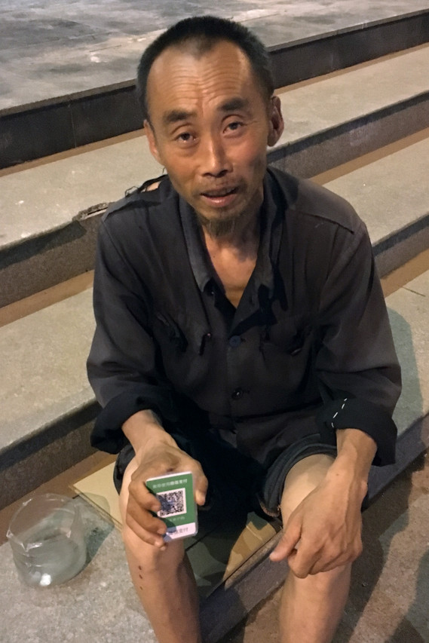
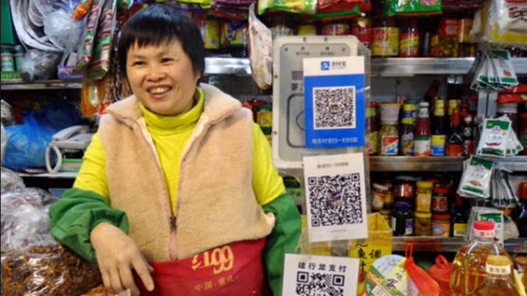

Slide 11
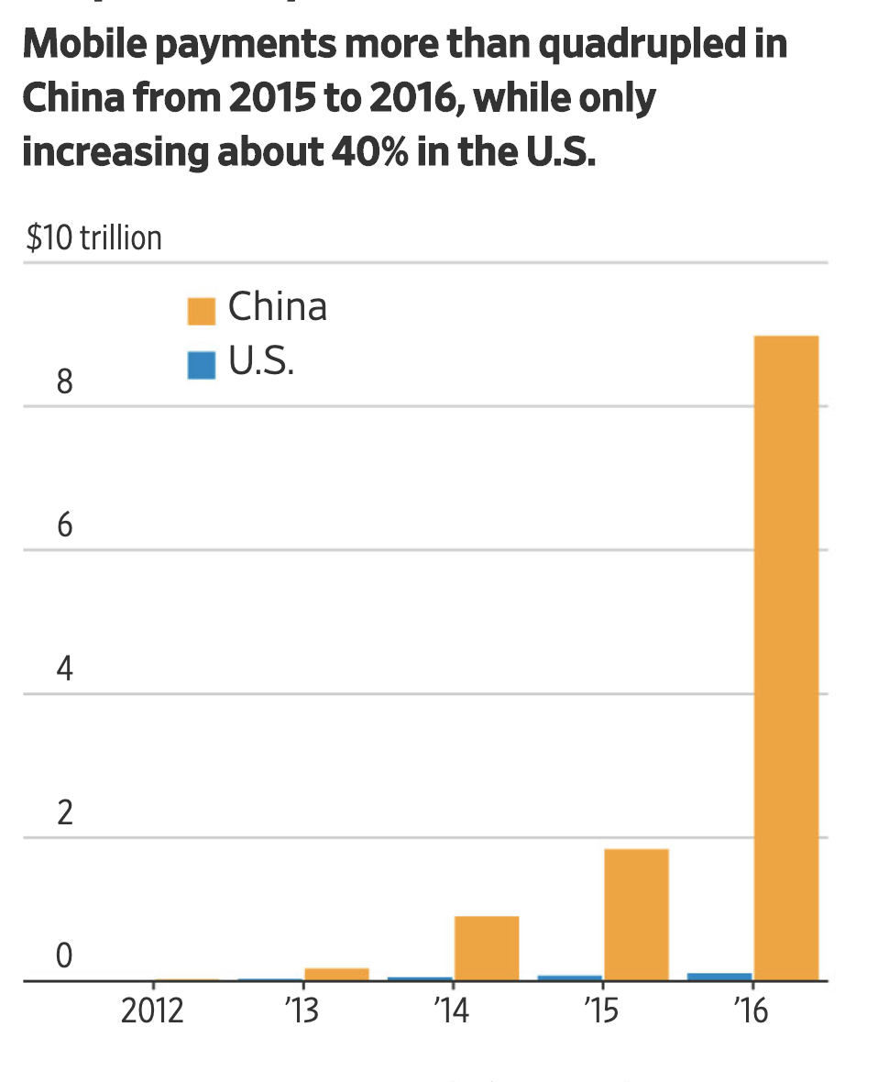
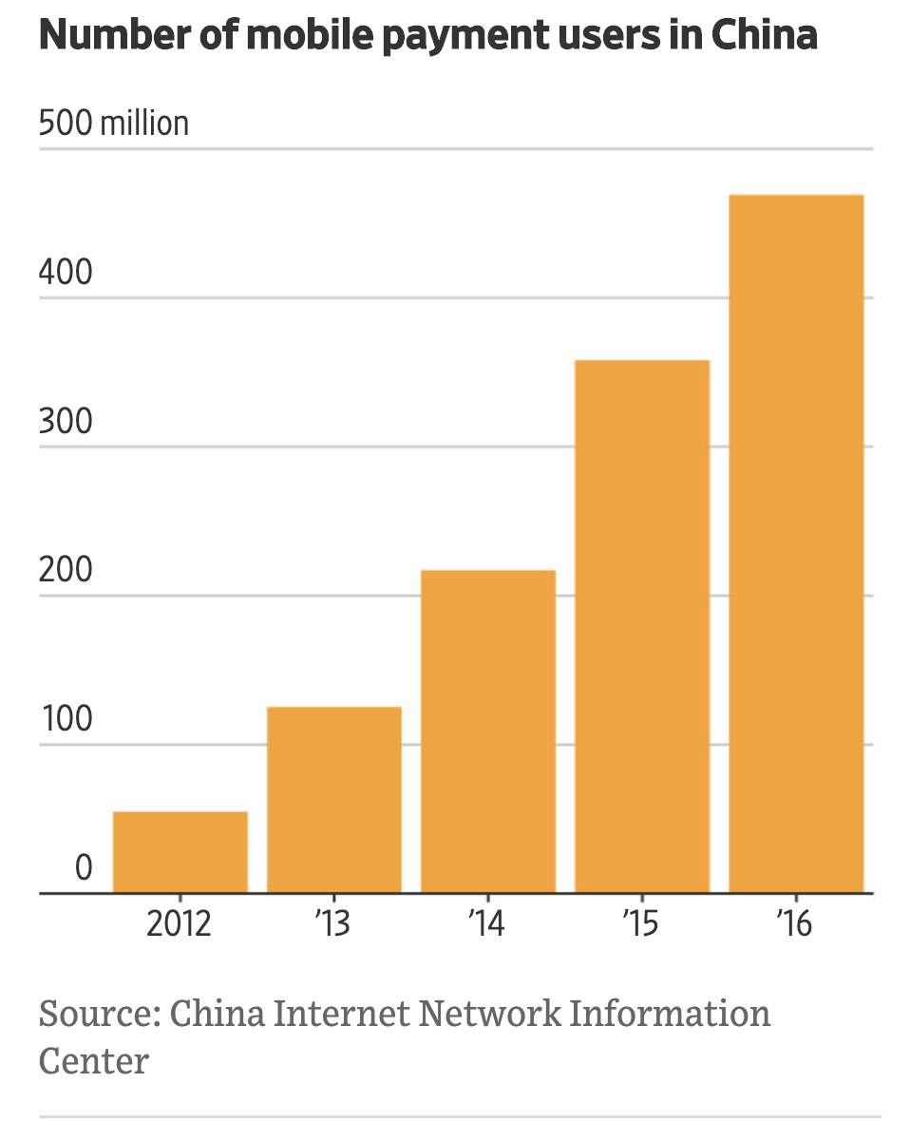
Cashless Pay & WeChat Pay
The Cashless Society Has Arrived— Only It’s in ChinaBy Alyssa Abkowitz
January 4, 2018

Slide 12
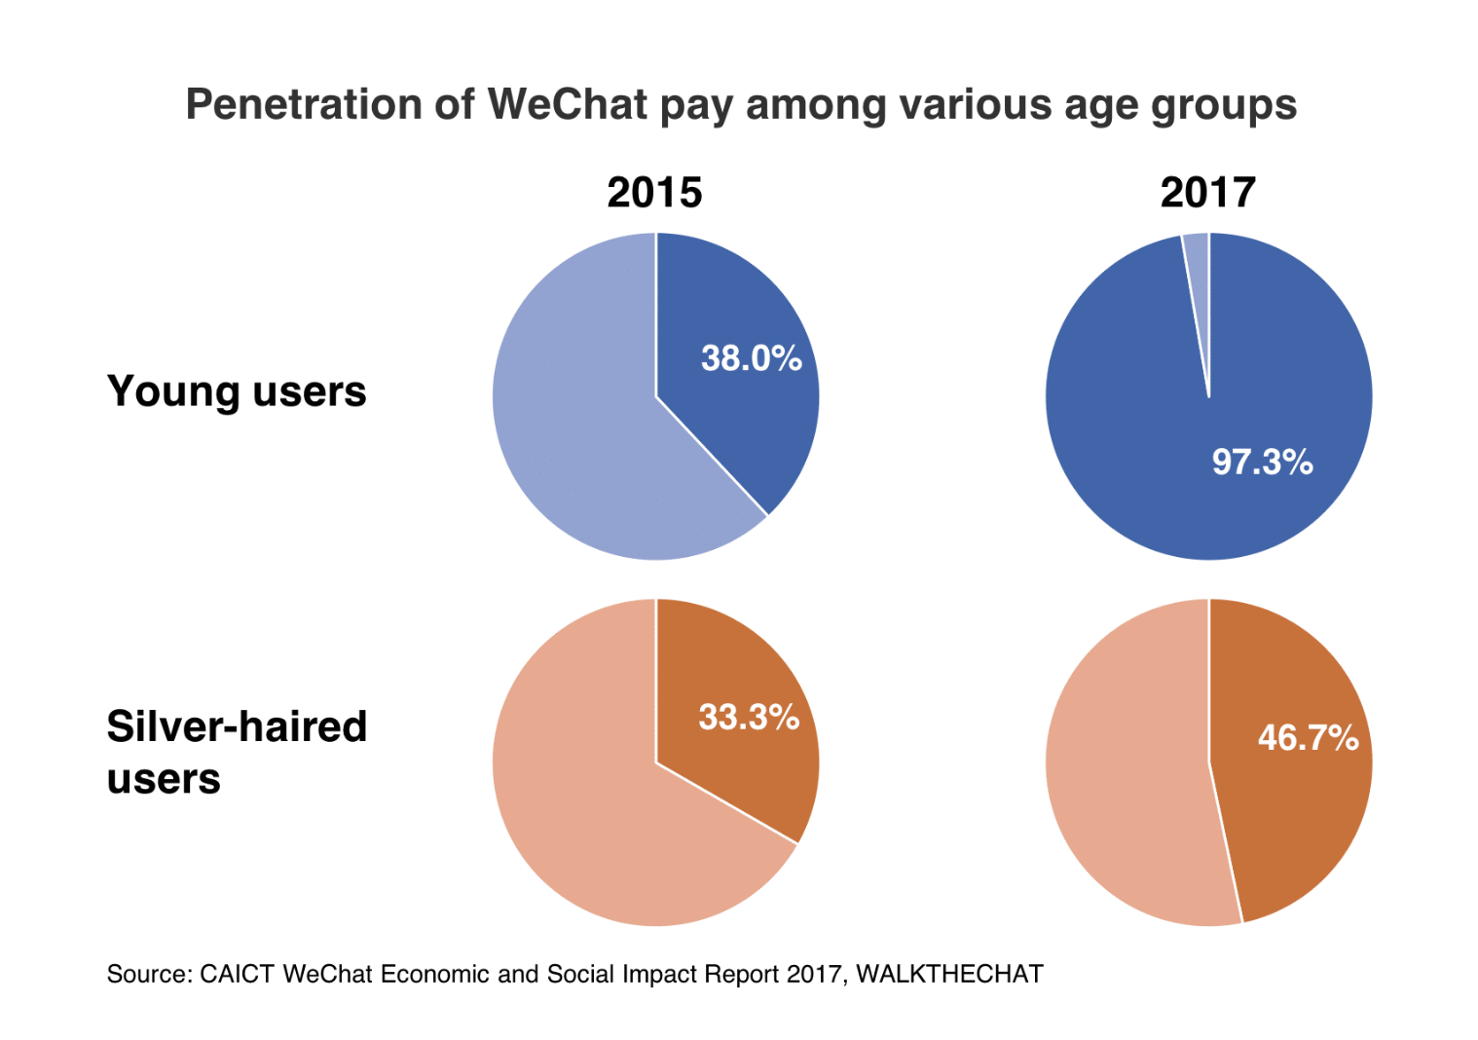
Cashless Pay & WeChat Pay
WeChat impact report 2018: all the latest WeChat data 。THOMAS GRAZIANI JULY 4, 2018

Slide 13
Cashless Pay & WeChat Pay
5 TECHs
dual interface CPU card (13.56MHz)
SIM Pass(13.56MHz) 、
RFID-SIM (2.4GHz) 、
NFC(13.56MHz) 、
Smart SIM Card
邱宜干.我国移动支付发展的瓶颈问题探讨[J].中国集体经济,2019(16):27-28.
Notes:
我国移动支付的方式主要是采用手机号与银行卡绑定的方式, 当前手机技术限制, 信息发送为明码plain code发送, 没有加密功能, 都是通过公网来传输, 手机号码、密码等重要的信息很容易就会被截取。
2012年6月21日, 中国移动China Mobile与中国银联签UnionPay署移动支付业务合作协议,标志着中国移动支付标准基本确定为13.56MHz标准

Slide 14
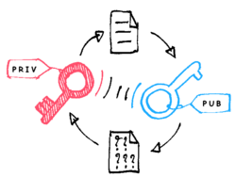
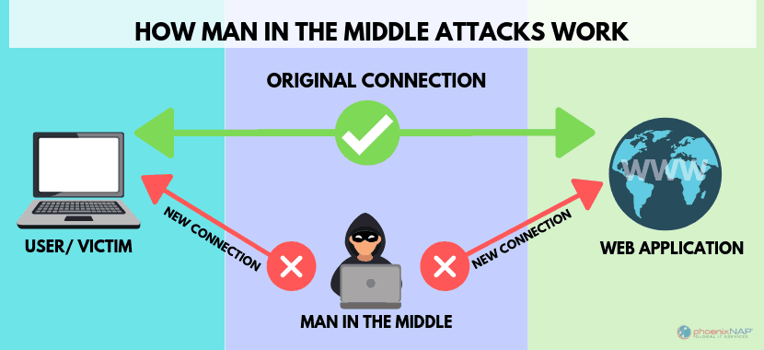


Cashless Pay & WeChat Pay
Man-in-the-middle attack
Phishing
Malware attack
Encryption algorithm crack
骆培培. 国密算法在移动支付中的应用研究[D].郑州大学,2017.
Notes:
Man in the middle attack :in the original data flow, data will send directly from client end to the server and an process all fucntions, but man in the middle will intercept the chain, the mid man is the stop of the tramsiation from user to server. In this attacked process, all information can be read,or can be modified.This type of attack is often seen in Fake Wifi hotspot.
Finsihing: attackers disguise themselves as banks or finance institution, they will send you email or link to gain your personal information. In Cashless payment , attackers will send you a fake QR code, then waiting for you to insert your bank account and password.
Malware attack: malware will be installed in to users device. Virus is a type of Malware
Encription algothm crack: It is difficult, but it is possible. Some of cryptology algorithm has been deciphered. In cashless payment, server end will create public key and private key via Public-key cryptographic algorithm. The pubilic key will be sent to client, then client end will create a random Symmetric-key. And then exchange with the encrypted public key. This process will lower the security. Keys will be leaked for either side is cracked.

Slide 15
Cashless Pay & WeChat Pay
Symmetric-key algorithm
Public-key cryptography
Hashing algorithm
Notes:
Symmetric-key algorithm encryption and deciperment use the same key, this algorithm is easy and fast.but the key management is complex. The key management decide how safe is your informatoin.
Pubilc key cryptology has public and private key, this algorithm is low and complex, but more safer and flexible..

Slide 16
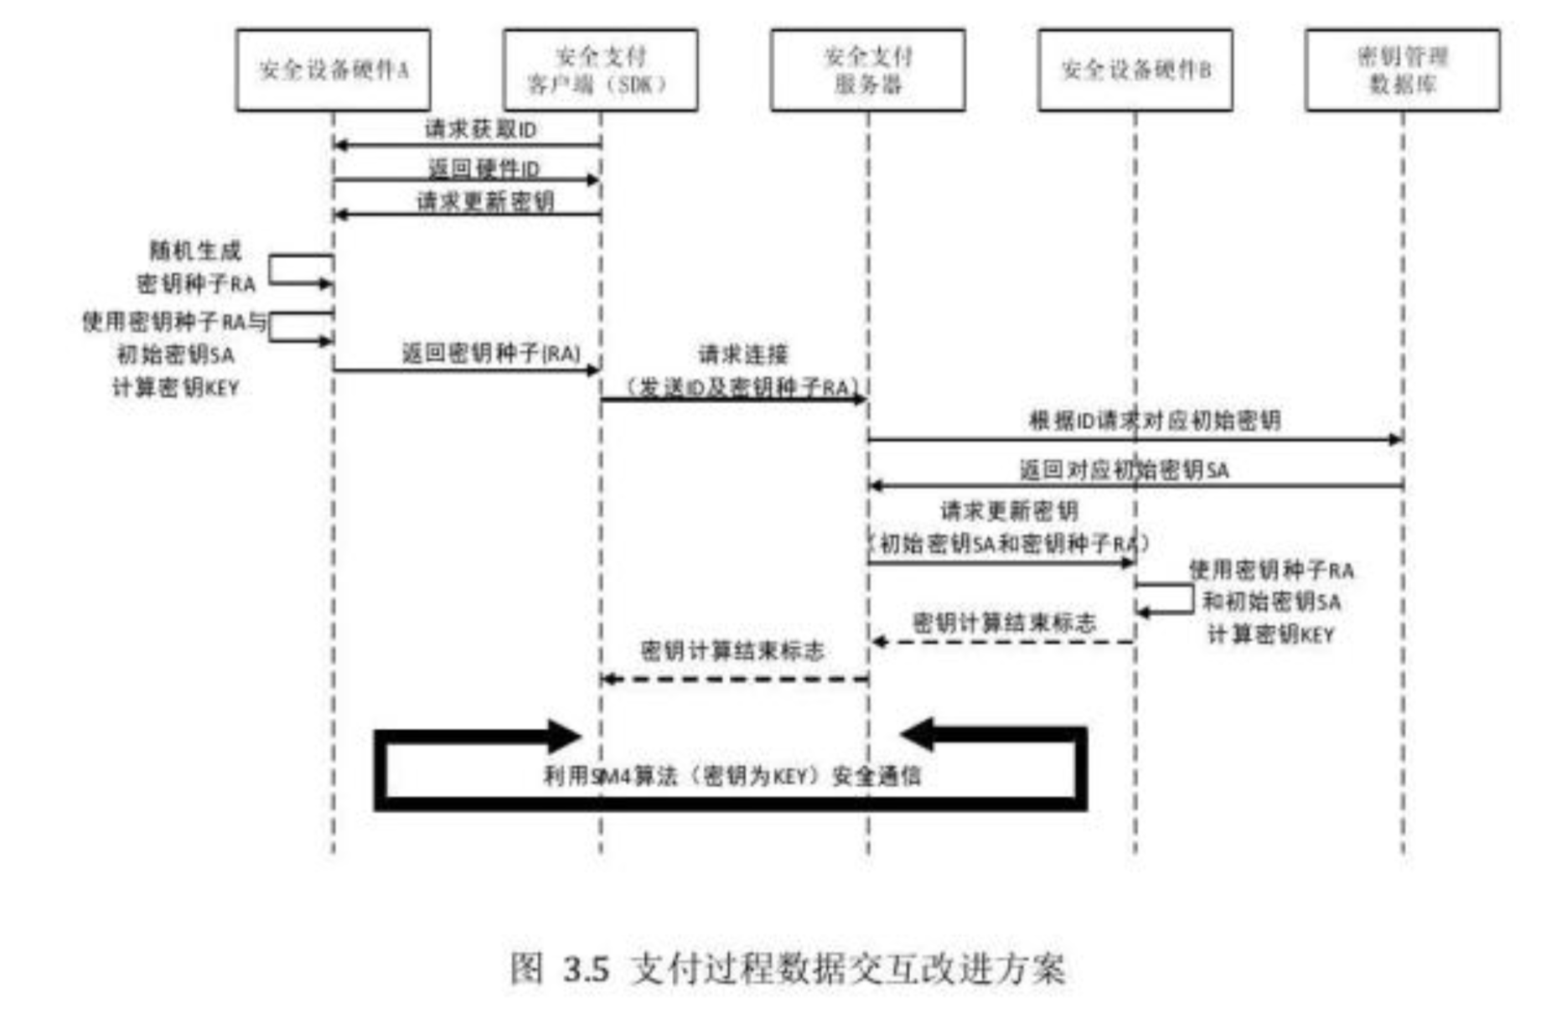
Notes:
Build up secrity device, set up key base, and maange the initial key
SM4 is a block cipher used in the Chinese National Standard for Wireless LAN WAPI.
Store the exclusive serial number ID and initial Key.
Create random Seed key.
Create an cryptology algorithm for basing on seed key and initial key
Encrypt and decipher.
Securit payment client SDK is is developed by the 3rd-party payment platform. It will encrypt data and communicate with the payment server.
SecrityPayment Client SDK get the serial ID A. this ID is unmodifiable, it is the only thine will recognize the sercity device.
Then Serity payment client SDK will ask to renew secuity key, when the device recieve the apply, will releace a radom seed key RA, and using the alogoritm to calculate the seed key RA and initial key SA to get the final key, as the key for SM4. Meanwile the Seed key will be returned to seceriy payment client SDK. When the SDK get seedkey RA, the RA will be send to payment server with serial ID. the server will check the key base and find the device initial SA. then send the SA with seedKey RA to security device B, After colulation, and B will get the security Key. if the Keys from A and B are the same, the communication will be achived udner the protection of SM4.

Slide 17
Data Privacy Policies Continued...

Slide 18
Recap of Concepts from Last Time
Right To Be Forgotten:
"The right to silence on past events in life that are no longer occurring."
Example: Asking to have a photo taken down
GDPR:
“A legal framework that sets guidelines for the collection and processing of personal information from individuals who live in the European Union (EU).”
Notes:
Briefly define again

Slide 19
Data Privacy Legislations Introduced In 2019
The Information Transparency and Personal Data Control Act
The Commercial Facial Recognition Privacy Act
An update to the Children's Online Privacy Protection Act (COPPA) of 1998
The Digital Accountability and Transparency to Advance Privacy Act
The American Data Dissemination Act

Slide 20
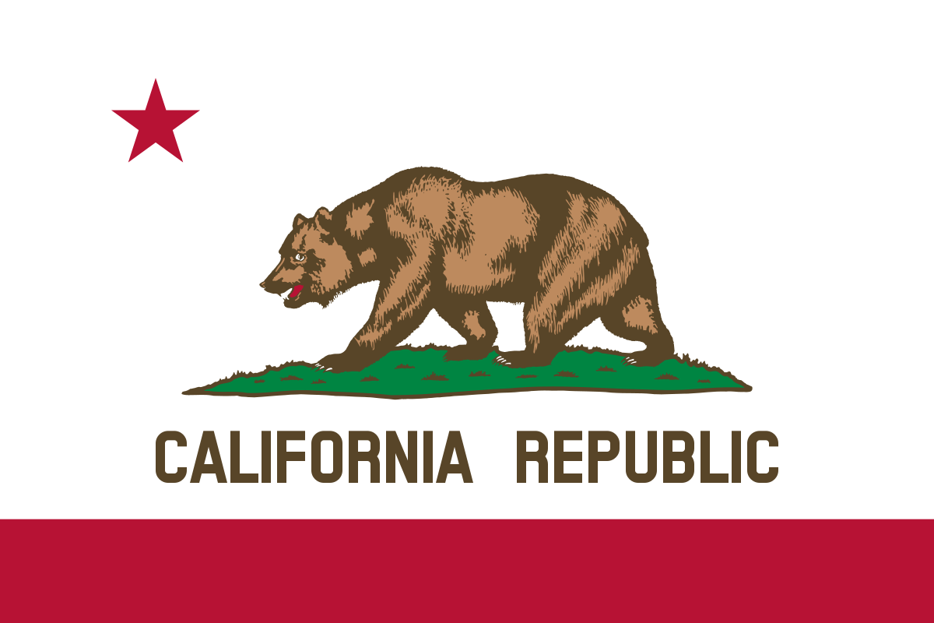
California Consumer Privacy Act (CCPA)
First state to pass a law on data privacy
Signed into Law on June 28, 2018
CCPA becomes effective on January 1, 2020
So what exactly is it?
Notes:
Know what personal data is being collected about them.
Know whether their personal data is sold or disclosed and to whom.
Say no to the sale of personal data.
Access their personal data.
Request a business delete any personal information about a consumer collected from that consumer.^{[8]}
Not be discriminated against for exercising their privacy rights.
is a bill that enhances privacy rights and consumer protection for residents

Slide 21
California Consumer Privacy Act (CCPA)
Issues:
Doesn’t affect everyone
Unlike GDPR, the act does not protect from data collecting
Wouldn’t require companies to get people’s permission to collect their information in the first place.
Notes:
even if a company sells a person’s information and that person asks it to stop, the company can still collect that information?
the company can keep collecting people’s personal information and sharing it for business purposes, so long as it complies with people’s requests to know what kind of information is being collected and who it’s being shared with?
unless a company operates its site or app in complete isolation — without any programmatic ads or traffic analytics software — it’s probably collecting people’s personal information and sharing it for business purposes?
What would it require?
Companies would have to tell California residents what kind of personal information they collect, but only if the resident asked to know. Then, if a company sells or shares that information with another company, it would have to tell the person who those other companies are, but only if asked. And if the company sells the information — but only if they do — the person could ask the company to stop selling it, and the company would have to honor the request.
Companies wouldn’t even have to let people opt out of having their data collected.

Slide 22
Any Questions?

